Slide 1

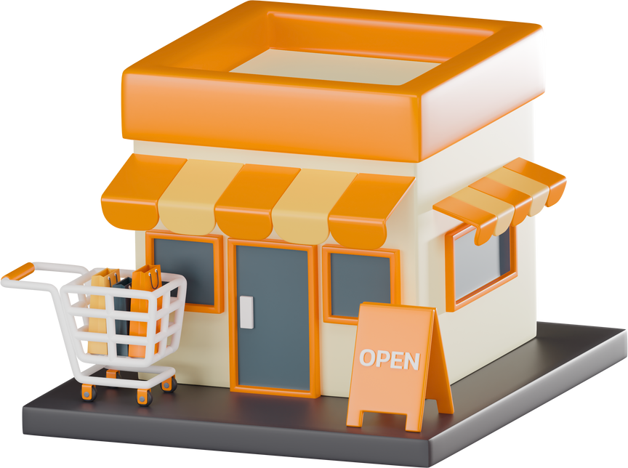
Data Analysis
Superstore Sales

Slide 2


محمد عفيفي على عبدالمنعم
سعيد حامد سعيد محمد
فريق العمل
ايمان فيصل محمد عمار
سوزيت ناجي يوسف اسعد
تحت اشراف
احمد رشاد حسين احمد
م/محمد عطية

Slide 3
Project Documentation Guidelines
Key points in the analysis
Tasks | Student Deadline
Data Cleaning and Preprocessing | Week 1
Analysis Questions Phase | Week 2
Dashboard Phase | Week 3
Recommendations & Insights and Final Presentation | Week 4

Slide 4

Data Cleaning and Preprocessing
At this stage, the work was done as follows:
1
Project Plan – Includes the Time distribution for each step
2
Task Assignment & Roles – Defines responsibilities for each team member.
3
Project Proposal – Overview of the project, objectives, and scope.
4
Cleaning data -to prepare it for analysis

Slide 5
Project Plan – Includes the Time distribution for each step
Task Assignment & Roles – Defines responsibilities for each team member.
Tasks were distributed to all team members during the period from 11/1/2024 to 11/30/2024.
1. Import data into Power BI from the appropriate Excel source.
2. Examine the data to detect missing values, errors, and duplicates.
3. Address missing values ​​through elimination or imputation.
4. Correct data errors (such as spelling errors or illogical values).
5. Transform the data into a format suitable for analysis (standardize formats, extract new variables).
6.Document all processes performed during the cleaning process to ensure transparency and reproducibility.
7. Hand over the cleaned data to the team to move to the analysis phase.

Slide 6
Project Proposal – Overview of the project, objectives, and scope.
This project aims to analyze Superstore Sales data to identify key factors affecting business performance. It will examine sales by category, product, and region while assessing the impact of shipping methods on customer satisfaction. The analysis will leverage tools like Excel and Power BI to extract insights and recommendations. The expected outcome includes reports and visualizations highlighting trends and strategies to increase profitability and improve operations.

Slide 7
Cleaning data -to prepare it for analysis
During the cleaning process there were a number of observations.
1
Table.TransformColumnTypes(#"Promoted Headers", {{"Order Date", type date}}, "en-GB")
2
Table.TransformColumnTypes(#"Changed Type with Locale", {{"Ship Date", type date}}, "en-GB")
3
Table.AddColumn(#"Changed Type with Locale1", "duration", each [Ship Date]-[Order Date])
4
Table.TransformColumnTypes(#"Added Custom",{{"duration", type number}})
5
Table.SelectRows(#"Changed Type", each not List.IsEmpty(List.RemoveMatchingItems(Record.FieldValues(_), {"", null})))
6
Table.Distinct(#"Removed Errors")
7
Table.RemoveColumns(#"Removed Duplicates",{"duration"})
8
Table.TransformColumnTypes(#"Removed Columns",{{"Sales", type number}})

Slide 8


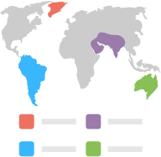
Analysis Questions Phase
General Analysis:
What are the total sales in each state?
Which categories have the highest sales?
Which sub-categories achieve the highest sales?
What is the average delivery time between the order date and the ship date?
1. Geographical Analysis:
What are the total sales by region?
Which city generate the highest sales?

Slide 9


Analysis Questions Phase
Customer Analysis:
Who are the top customers based on total sales?
Who are the top customers based on order?
Time-Based Analysis:
How are sales distributed monthly or annually?
Is there a seasonal sales pattern?
Which time period achieves the highest sales?

Slide 10


Analysis Questions Phase
Product Analysis:
1. Which products have the highest sales?
2. Which products have the lowest sales?
Shipping Method Analysis:
1. Which shipping methods are used the most, and what is their impact on sales?
2. What is the average delivery time for each shipping method?

Slide 11



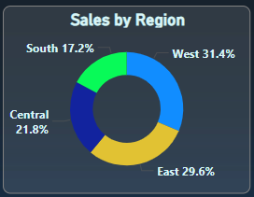
Super Store Sales Dashboard
What are the total sales by region?
Analysis
The east region is the highest and the South region is the lowest.

Slide 12
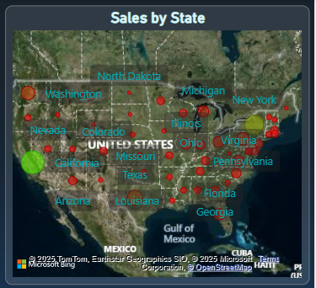
Super Store Sales Dashboard
What are the total sales in each state?
Which states have the highest sales?
Analysis
Larger circles (such as those in California and New York) indicate higher sales.
Green color represents high sales.
Red color represents low sales.
The highest sales appear in California, New York, and Michigan.
Lower sales are seen in states like North Dakota and Missouri.

Slide 13
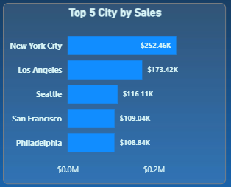
Super Store Sales Dashboard
Which City generate the highest sales?
Analysis
New York City is the highest in terms of sales.

Slide 14
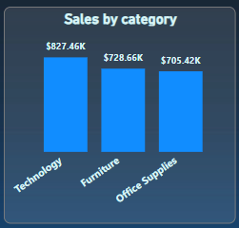
Super Store Sales Dashboard
Which categories have the highest sales?
Analysis
The chart titled "Sales by Category" presents sales data for three product categories:
Technology: Highest sales at $827.46K.
Furniture: Second with $728.66K in sales.
Office Supplies: Lowest sales at $705.42K.
Technology is the top-performing category, indicating strong customer demand.
Furniture follows closely, showing moderate performance.
Office Supplies has the lowest sales, which could be due to lower demand or market saturation.

Slide 15
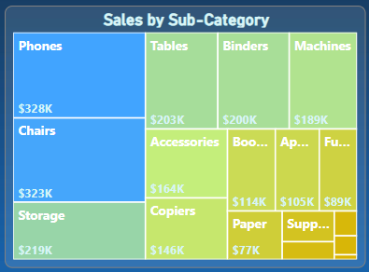
Super Store Sales Dashboard
Which sub-categories achieve the highest sales?
Analysis
Top-selling sub-categories:
Phones: $328K
Chairs: $323K
Storage: $219K
Lowest-selling sub-categories:
Paper: $77K
Supplies: $68K (partially visible)
The size of each block represents the sales volume — larger blocks = higher sales.

Slide 16
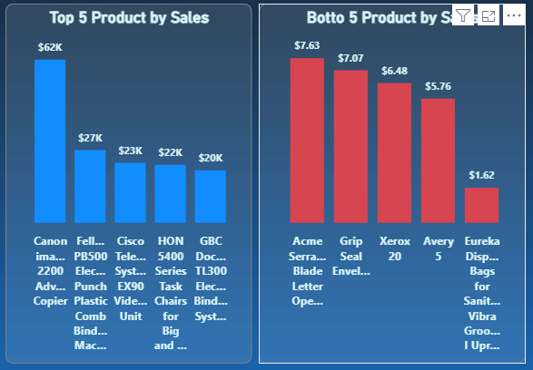
Super Store Sales Dashboard
1. Which products have the highest sales?
2. Which products have the lowest sales?
Analysis
"Bottom 5 Product by Sales":
Acme Sierra Blade Letter Opener: $7.63
Grip Seal Envelopes: $7.07
Xerox 20: $6.48
Avery 5: $5.76
Eureka Disposable Bags for Sanitaire Vibra Groomer I Upright: $1.62
In this chart, the first four lowest-performing products have relatively similar sales figures (between $5.76 and $7.63), while the Eureka product significantly underperforms at just $1.62.
The contrast between the charts highlights the extreme difference in revenue generation between top and bottom products - the best-selling Canon copier ($62K) generates nearly 38 times more revenue than the lowest-performing Eureka bags ($1.62), demonstrating a significant sales disparity across the product range.
"Top 5 Product by Sales":
Canon image 2200 Advanced Copier: $62K - Significantly outperforming all other products
Fellows PB500 Electric Plastic Comb Binding Machine: $27K
Cisco TelePresence System EX90 Video Conference Unit: $23K
HON 5400 Series Task Chairs for Big and Tall: $22K
GBC DocuBind TL300 Electric Binding System: $20K
The distribution shows a substantial gap between the top-selling product and the rest of the items. The Canon copier generates more than twice the sales of the second-place product.

Slide 17
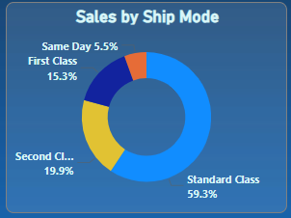
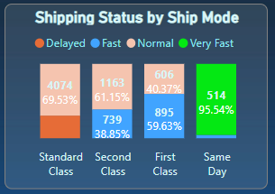
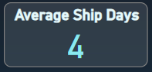
Super Store Sales Dashboard
Which shipping methods are used the most, and what is their impact on sales?
What is the average delivery time for each shipping method?
What is the average delivery time between the order date and the ship date?
Analysis
Average Ship Days: 4 days as shown in the first indicator.
Sales by Ship Mode:
Standard Class: 59.3%
Second Class: 19.9%
First Class: 15.3%
Same Day: 5.5%
Shipping Status by Ship Mode:
Same Day: 95.54% Very Fast (514 shipments)
First Class: Mix of Normal (59.63%) and Fast (40.37%) shipments
Second Class: Mix of Fast (38.85%) and Delayed (61.15%) shipments
Standard Class: Mostly Delayed (69.53%)
This information indicates that Same Day shipping is the most efficient service, while Standard Class shipping suffers from delays despite being the most frequently used option.

Slide 18
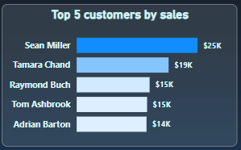
Super Store Sales Dashboard
Who are the top customers based on total sales?
Analysis
a bar chart titled "Top 5 customers by sales." Here's an analysis of the displayed data:
Sean Miller: Leads the list with sales of $25,000 ($25K)
Tamara Chand: Ranks second with sales of $19,000 ($19K)
Raymond Buch: Takes third place with sales of $15,000 ($15K)
Tom Ashbrook: Comes in fourth with sales also at $15,000 ($15K)
Adrian Barton: Holds fifth place with sales of $14,000 ($14K)
There's a significant gap between the first and second customer ($6,000), while the differences between the second through fifth customers are relatively smaller. It's notable that Sean Miller represents an important income source for the company, as his sales constitute approximately 28% of the total sales shown in this chart.

Slide 19
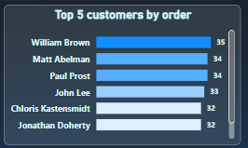
Super Store Sales Dashboard
Who are the top customers based on order?
Analysis
This image shows a bar chart titled "Top 5 customers by order." Here's an analysis of the displayed data:
There's an interesting observation when comparing this to the previous sales chart - while Sean Miller had the highest sales value ($25K), he ranks third in order count. Adrian Barton, who had the lowest sales value among the top 5, places first in number of orders. This suggests Adrian Barton places more frequent but lower-value orders, while Sean Miller makes fewer but higher-value purchases. Raymond Buch maintains strong performance in both metrics, ranking second in orders and third in sales value.

Slide 20
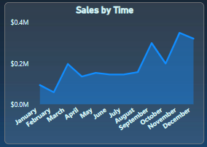
Super Store Sales Dashboard
How are sales distributed monthly or annually?
Analysis
The chart displays sales values ranging from approximately $0.0M to $0.4M, with the following key observations:
January: Sales start relatively low (around $0.1M)
February: Shows a notable increase
March-April: Sales peak at around $0.2M in March, then decline slightly in April
May-August: Sales maintain relatively stable levels between $0.15M-$0.18M
September-October: Significant growth occurs, reaching approximately $0.3M in October
November: A temporary dip in sales
December: Sales reach their highest point of the year at nearly $0.4M
The overall trend shows a general upward trajectory throughout the year, with the strongest performance in Q4 (despite November's dip). The chart demonstrates clear seasonality with peaks in March, October, and particularly December, suggesting possible holiday season impacts on sales. The first half of the year shows more volatility, while the second half demonstrates stronger and more consistent growth.

Slide 21
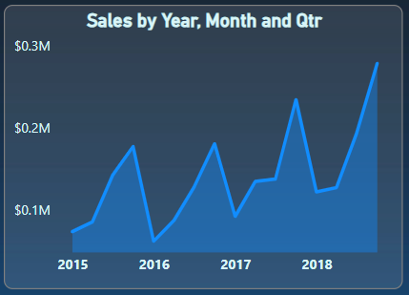
Super Store Sales Dashboard
Which time period achieves the highest sales?
Is there a seasonal sales pattern?
Analysis
From the graph, we notice that sales of the highest package increase at the end of each year and decrease in the first quarter of each year. There is also an increase in the numbers from one year to the next.

Slide 22

📊 Superstore Sales Data Analysis Report
🔹 Sales Analysis
🔹 Top Customers by Total Sales
Total number of orders: 9,800 orders.
Average sales per order: $230.77.
Minimum sales for a single order: $0.44.
Maximum sales for a single order: $22,638.48.
Sean Miller – $25,043.05
Tamara Chand – $19,052.22
Raymond Buch – $15,117.34
Tom Ashbrook – $14,595.62
Adrian Barton – $14,473.57

Slide 23
📊 Superstore Sales Data Analysis Report
🔹 Top-Selling Products by sales
🖨 Canon imageCLASS 2200 Advanced Copier – $61,599.82
📞 Cisco TelePresence System EX90 Videoconferencing Unit – $22,638.48
💺 HON 5400 Series Task Chairs for Big and Tall – $21,870.58
🔹 Top States by Total Sales
California – $446,306.46
New York – $306,361.15
Texas – $168,572.53
Washington – $135,206.85
Pennsylvania – $116,276.65

Slide 24
📊 Superstore Sales Data Analysis Report
🔹 Top-Selling Product Categories
🔹 Shipping Mode Analysis
Technology – $827,455.87 🖥
Furniture – $728,658.57 🪑
Office Supplies – $705,422.33 📎
Standard Class – 5,859 orders 🚛
Second Class – 1,902 orders 📦
First Class – 1,501 orders ✈
Same Day – 538 orders ⚡

Slide 25
📊 Superstore Sales Data Analysis Report
🔍 Recommendations & Insights
Focus on Technology products as they generate the highest revenue.
Strengthen marketing strategies in California and New York due to high sales volume.
Consider optimizing fast shipping options to boost sales for high-value products.
Focus on Top Customers
Create loyalty programs and exclusive discounts.
Maintain and strengthen relationships with key customers.

Slide 26
📊 Superstore Sales Data Analysis Report
🔍 Recommendations & Insights
Reevaluate Underperforming Products
Low-performing products: Eureka Disposables and Avery 5.
Recommendation: Analyze root causes (pricing/marketing) or consider removing them from the market.
Leverage Best-Selling Products
Example: Canon Copier with sales exceeding $60K.
Recommendation: Increase promotion and ensure adequate stock to meet demand.
Improve Regional Performance
East = 29.6% of sales | South = only 17.2%.
Recommendation: Boost marketing efforts in low-performing regions like the South.

Slide 27
📊 Superstore Sales Data Analysis Report
🔍 Recommendations & Insights
Focus on the “Consumer” Segment
Consumers account for over 50% of total sales.
Recommendation: Expand product offerings and marketing strategies targeting this segment.
Analyze Seasonal Sales Trends
Peak sales in November and December.
Recommendation: Maximize promotions during these high-demand months.
Reduce Average Shipping Time
Current average = 4 days.
Recommendation: Use "Same Day" and "Second Class" shipping, especially in major cities.
Faster shipping = higher satisfaction = more sales.

Slide 28
📊 Superstore Sales Data Analysis Report
🔍 Recommendations & Insights
Geographic Focus on High-Performing Areas
Such as New York, California, and Texas.
Recommendation: Strengthen advertising and logistics presence, open branches or warehouses nearby to speed up delivery and improve customer experience.

